Slide 1
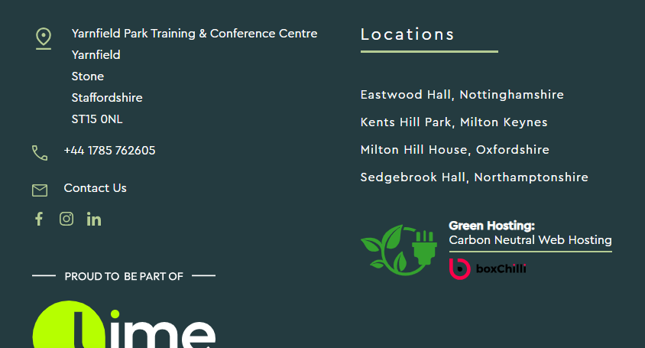
Youth Camp 2025;
Dates; 23-25 July 2025.
24 Hour PM Package x2: £70 Per Person Per package, based on two sharing. (50 rooms all together) I have allocated 40 twin rooms ( two single beds) and 10 double (one double bed). Starting with dinner on 23 th and ending with lunch, plus the meeting room until 5pm on the 23-25.

Slide 2
What's included:
Restaurant Dinner
En-Suite Accommodation
Restaurant Breakfast
Restaurant Lunch
Meeting Room Hire
Free Car Parking (400 spaces)
Free Wi-Fi -1000 Mbps sustaining up to 800 simultaneous devices
Flipcharts/Pens/Conference Pads/Pencils
Sound and Projection Facilities

Slide 3
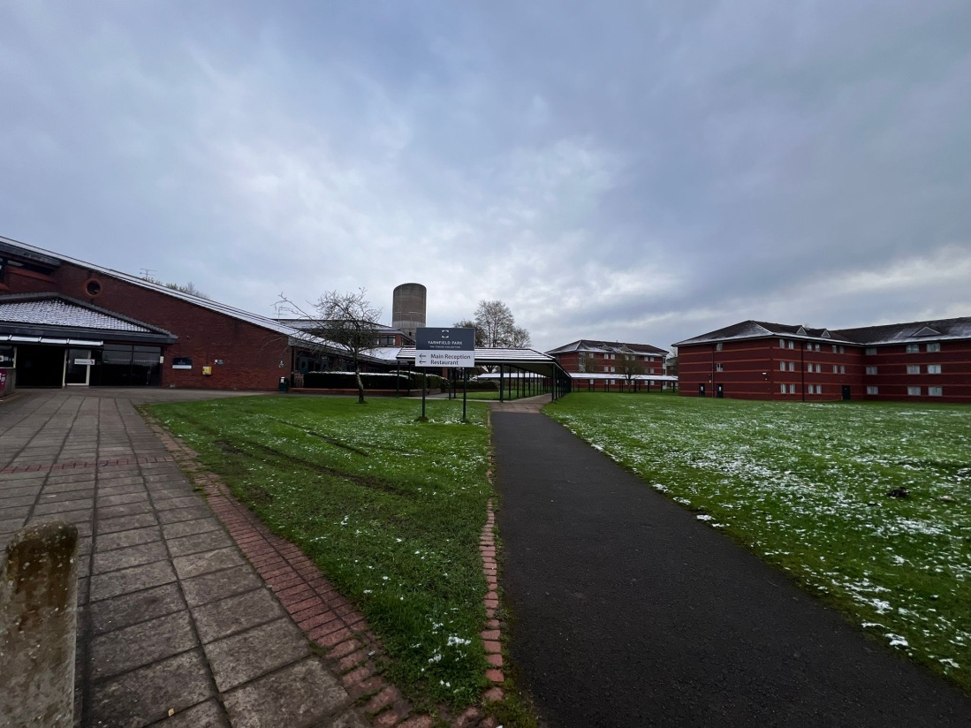
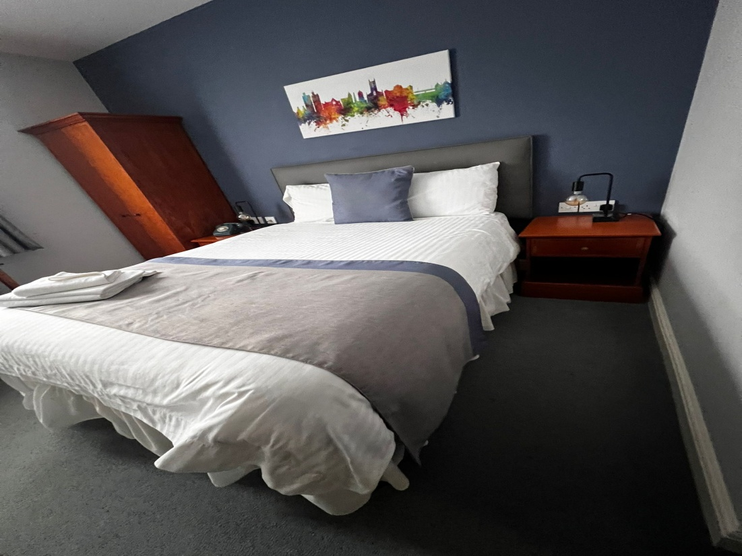
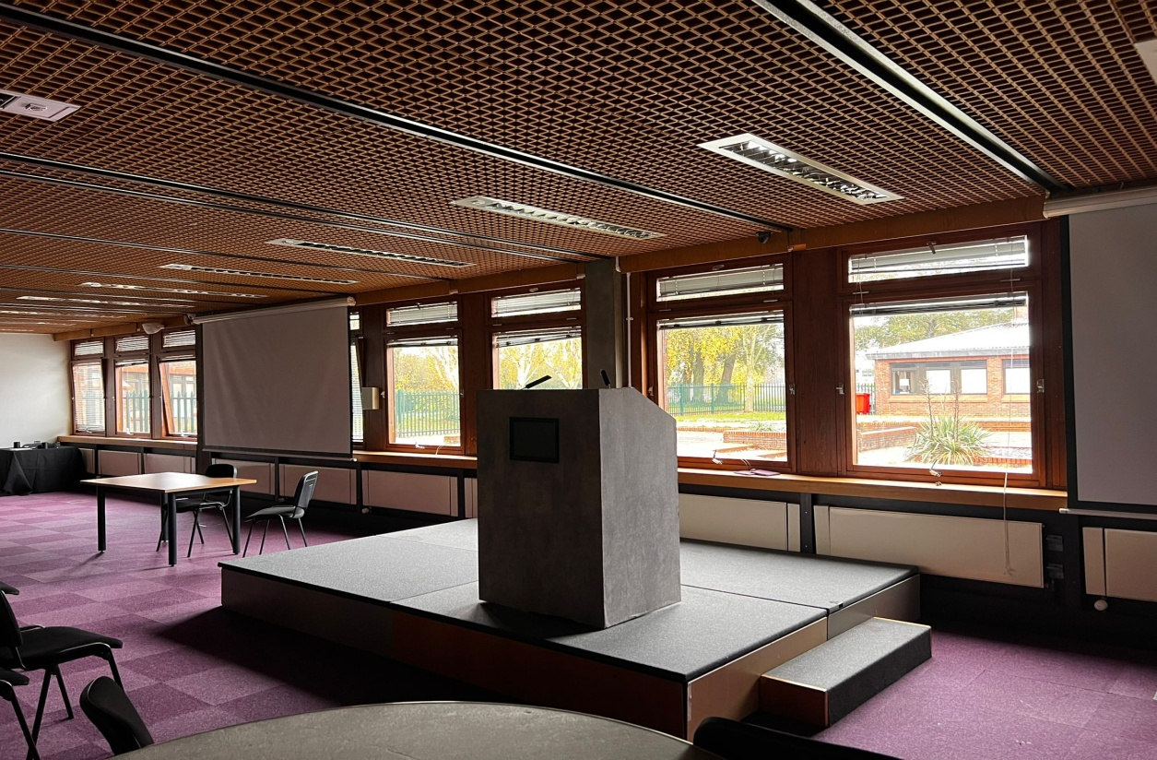

Slide 4
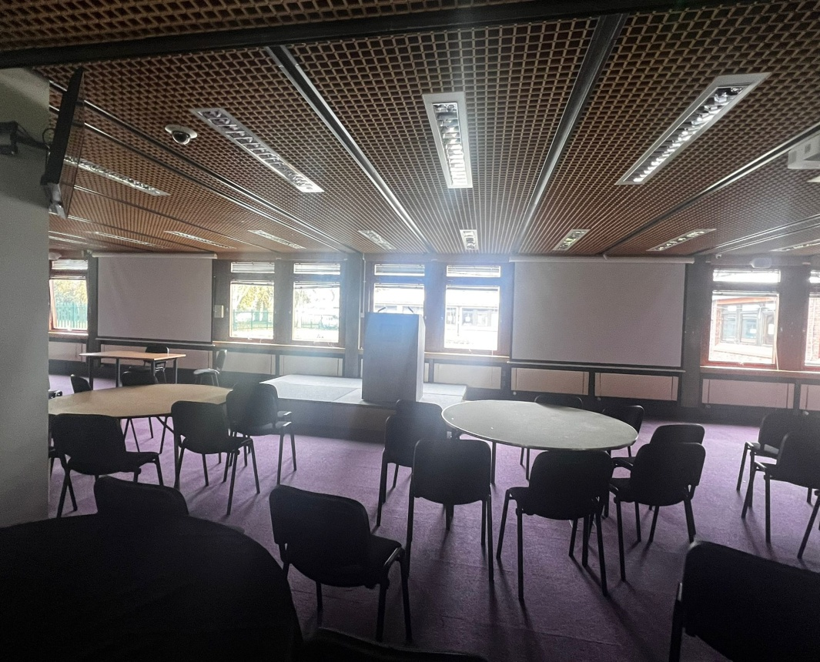
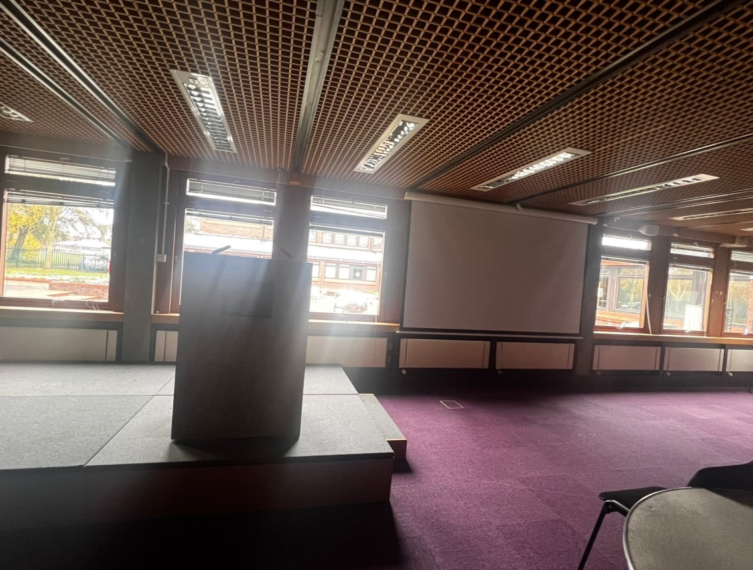
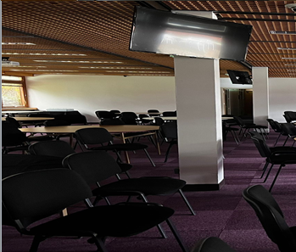
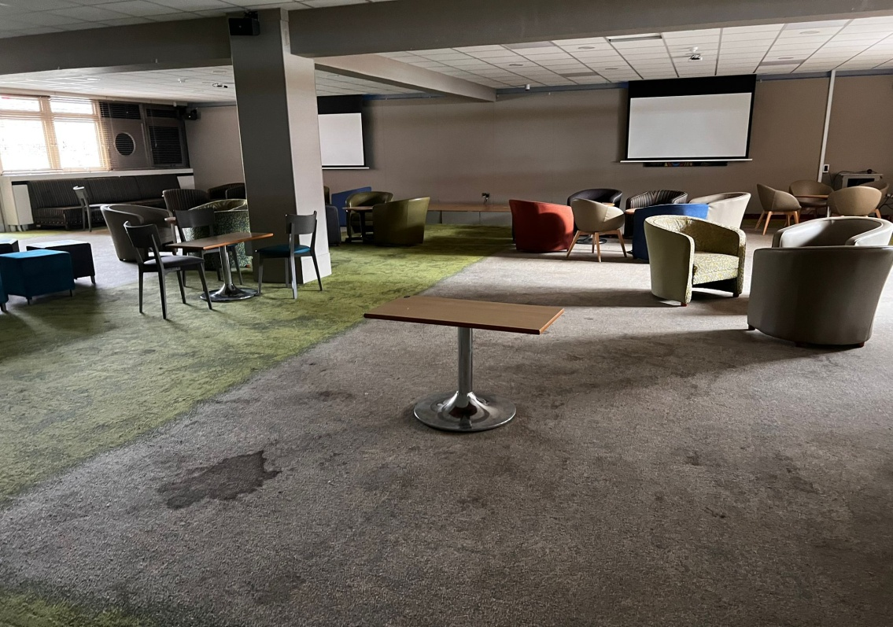

Slide 5
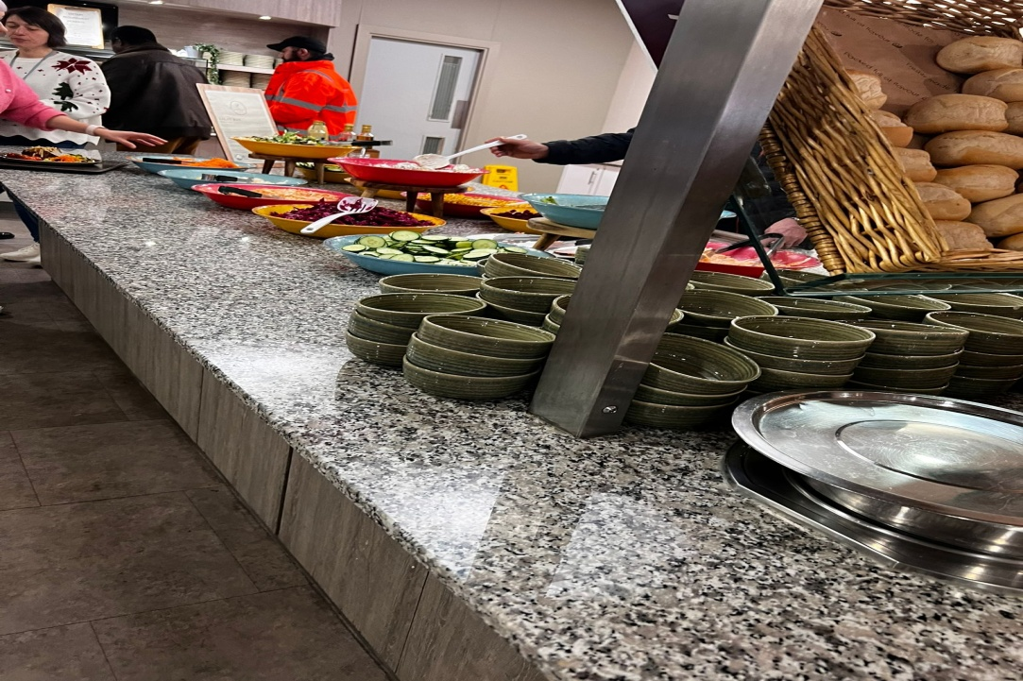
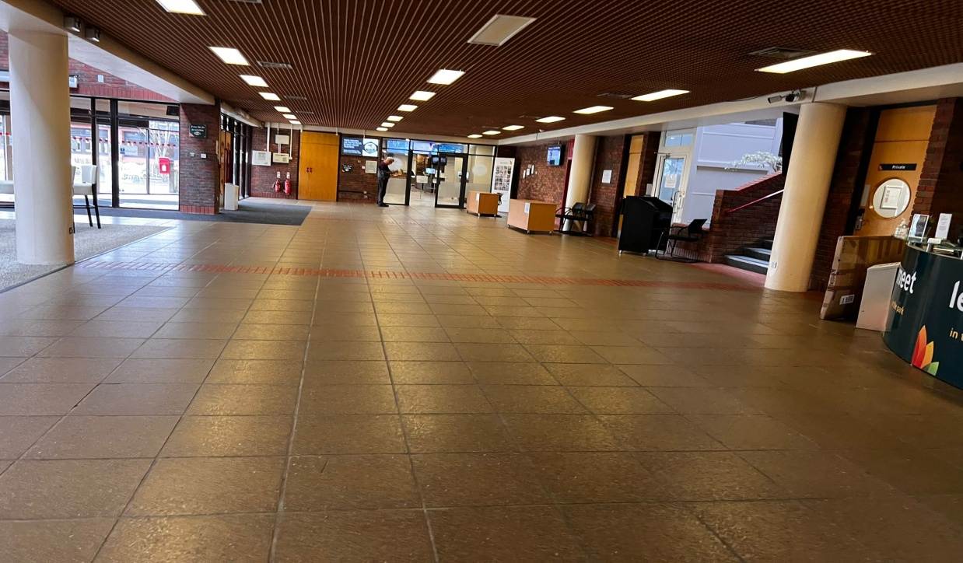
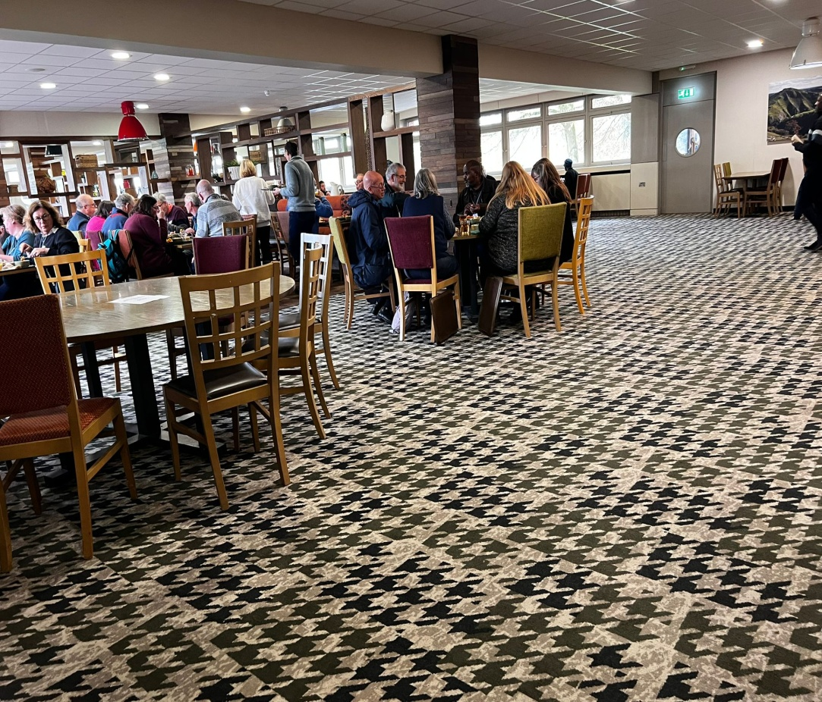
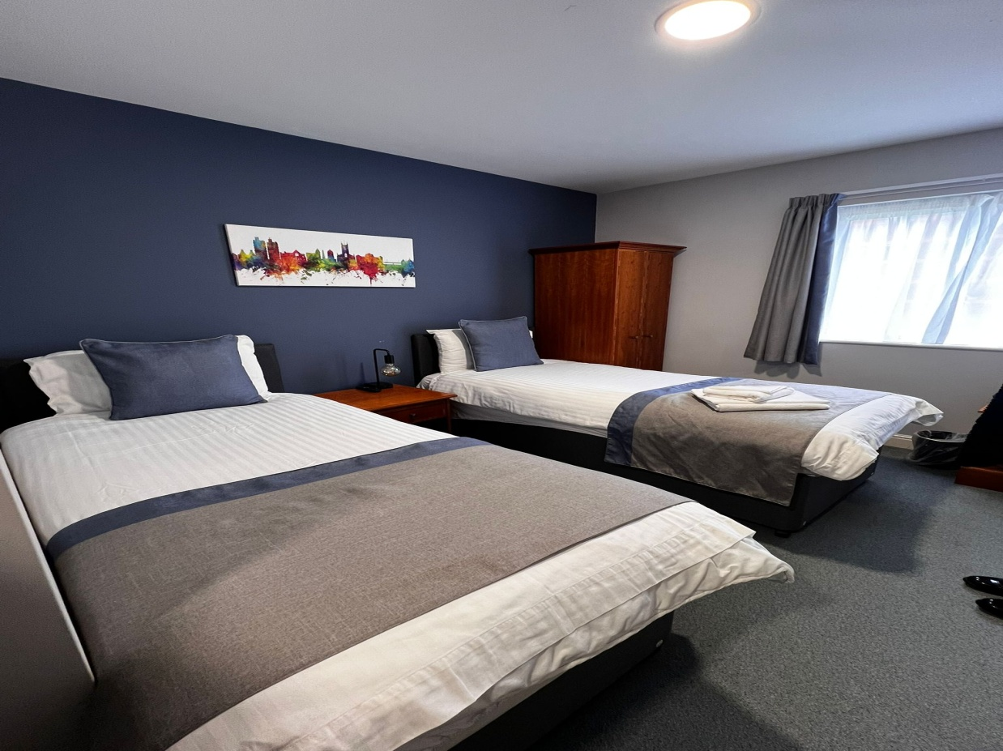

Slide 6
